Slide 1
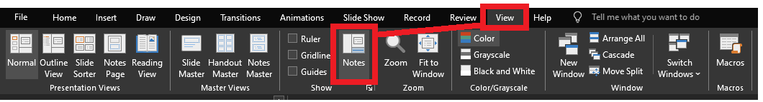
Reviewing after the presentation?
Be sure to enable the Notes for slide-specific content

Slide 2




Chew on That!:
Sending DataTables and DataFrames to SQL Stored Procedures

Slide 3
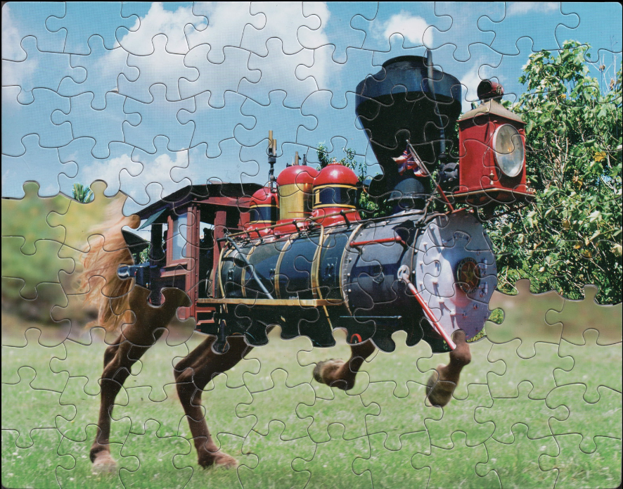
With permission from Tim Klein, www.puzzlemontage.com
Notes:
What do you see here?
Scenario 1: The RBAR solution failed updating from horse to train and didn’t revert.
Scenario 2: Someone is reading the data while the RBAR solution is still updating data. (Maybe a transaction is involved, maybe not)
Scenario 3: Two individuals are independently updating the puzzle at the same time.

Slide 4
Why send all the rows at once?
All the data is related. Either all of it updates as a unit or none of it does.
Keep the lifetime of the transaction to a minimum
Avoid staging-table management
  procs to pre-clean the staging tables
  procs to swap the data afterwards
Avoid session management
  Even worse if everyone uses the same common application login
Notes:
If two users are competing to update the same puzzle, I’d rather the last user to update win… then for all users be unhappy.

Slide 5





Jeff Foushee
SQL Server Database Admin
Programmer
SQL Saturday speaker
Blackjack dealer
https://www.linkedin.com/in/jeff-foushee/
https://github.com/jbfoushee/MyPresentations/

Slide 6
Life without UDTTs – Row-by-Agonizing-Row
Stg_Tbl.Truncate()
  SQL.TryConnect()
  SQL.Cmd.TryExec("TRUNCATE TABLE dbo.Staging_Tbl")
  SQL.Close()
Stg_Tbl.Load()
  foreach(row) {
    SQL.TryConnect()
    SQL.Cmd.TryExec("EXEC dbo.AddStgData(@p1=, @p2=,…")
    SQL.Close()
  }
Stg_Table.Swap()
  SQL.TryConnect()
  SQL.Cmd.TryExec("EXEC dbo.SwapLiveDataWithStg()")
  SQL.Close()
Pain-point
Notes:
The pain point is the Load() routine: Connection management, input formatting, looping cycles

Slide 7
INSERT INTO dbo.MyTable
(IntCol_1, IntCol_2)
VALUES (1, 2)
“tuple”
, (3, 4)
, (5, GETDATE() )
One complete transaction
All rows must commit together
All values must agree in their respective data signatures
Notes:
A tuple is a finite ordered sequence of elements.
Here’s a way to get more than row into the database
The comma is separating multiple tuples of information to be added to the table
But we aren’t sending dynamic SQL to the database, so this isn’t a viable option

Slide 8


Location 1
Location 3
On-prem SQL Server (2008+)
Azure SQL Database
Azure SQL Managed Instance
Parallel Data Warehouse (PDW)
Analytics Platform System (APS)
Azure Synapse Analytics SQL pool
Location 2
Notes:
PDW/APS does not understand the User-defined Table Type at this time
This is the setup for our overall example.
3 or more factories report measurements to the central database.
All the measurements belong to one timestamp; I cannot use a mixture of measurements from different timestamps.

Slide 9
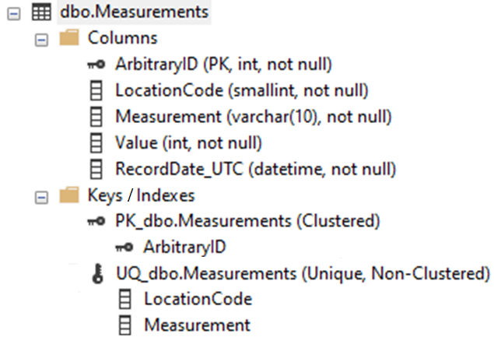
The back-end SQL Server table
Primary Key
Composite Key
Notes:
If time allows, why did I choose an ArbitraryID to serve as PK rather than LocationCode?
The primary key determines how your data is stored on disk.
I do not care that Location 1 is always reorganized to be the first location on disk.
That is a lot of wasted I/O.

Slide 10
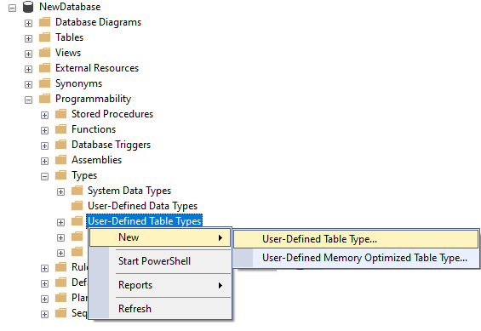
Create the User-Defined Table Type (UDTT)
CREATE TYPE [dbo].[Type_Measurements] AS TABLE
(
[Measurement] [varchar](10) NOT NULL,
[Value] [int] NOT NULL,
PRIMARY KEY CLUSTERED
(Measurement ASC)
WITH (IGNORE_DUP_KEY = OFF)
)
GO
Notes:
Within the database, expand Programmability, Types.
Right-click “User-Defined Table Types” and select New “User Defined Table Type”
We are going to build one that holds a collection of measurements and values.
The Location column could have been added, but it would be a repeating value when sent over.

Slide 11
Create the proc to interact with the UDTT
CREATE PROCEDURE [dbo].[usp_Measurements_Upsert]
@LocationCode smallint
, @dt_Measurements [dbo].[Type_Measurements] READONLY
AS
BEGIN
...(T-SQL MERGE statement. Let’s see it in demo)
END
The table-valued parameter "@dt_Measurements" must be declared with the READONLY option.

Slide 12
Demo Time
Notes:
Remember to start SQL Profiler for class and focus on login “app”
Add “RPC:Starting” and “Exception”
Attempt to do everything by SSMS.

Slide 13
Grant the security on the proc
CREATE ROLE MeasureProc_Executor AUTHORIZATION dbo
GRANT EXECUTE ON dbo.usp_Measurements_Upsert TO MeasureProc_Executor
GRANT EXECUTE ON TYPE::dbo.Type_Measurements TO MeasureProc_Executor
/*
--if new login to database...
CREATE USER [login_alias] FOR LOGIN [login_name]
*/
ALTER ROLE [MeasureProc_Executor] ADD MEMBER [login_alias]
Not available by the GUI in SSMS!

Slide 14
Already some concerns? (1/6)
May have to involve the DBA
  db_owner / db_ddladmin to create the proc/UDTT
  db_owner / db_securityadmin to manage the role
Notes:
Keep in mind, you would have the same issue with staging tables, so this may not be an issue to you.

Slide 15
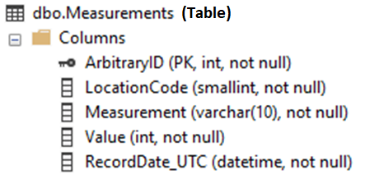
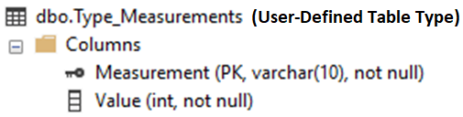
Already some concerns? (2/6)
Meta-data synchronization
  SQL Table to SQL UDTT (datatypes, lengths, column names )
  SQL UDTT to code (positionals, datatypes, lengths, column names )
1: var dt = new DataTable();
2: dt.Columns.Add("MeasureName", typeof(string));
3: dt.Columns.Add("Value", typeof(int));
Notes:
Don’t send columns or data you don’t need.
Your mileage will vary on the resources given to tempdb.

Slide 16
Already some concerns? (3/6)
A UDTT cannot be altered. It can only be dropped/recreated
When a UDTT is dropped, its permissions are dropped as well
The only known way to GRANT on a UDTT is by T-SQL at this time
  GRANT EXECUTE ON TYPE::dbo.Type TO <RoleName>
Notes:
As we saw in SSMS, there is no alternative to the TSQL GRANT EXECUTE statement

Slide 17
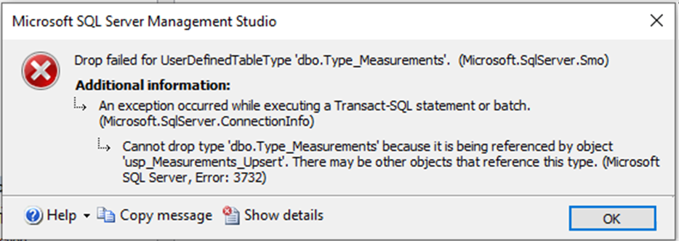
Already some concerns? (4/6)
No objects can rely on UDTT before UDTT can be dropped
Notes:
That stored proc that depends on the UDTT ? Yeah, you have to drop that proc before you can drop the UDTT.

Slide 18
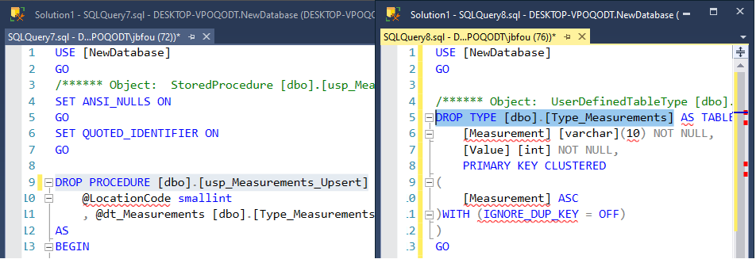
(When a proc is dropped, its permissions are dropped as well)
Notes:
Make sure you PAY ATTENTION when you have two windows up with two definitions that you just dropped.
Don’t let anyone distract you where you accidentally close windows, or you’ll have to restore a proc/UDTT from backup! (Shameful)
This is why you grant objects to roles, not to individuals

Slide 19
Already some concerns? (5/6)
Versioning
  Structure of the UDDT changes
    more/less columns
    Requires a new proc to handle the change
    How/Will you force users to new proc/UDDT?
    How to identify old/new versions?
Notes:
Don’t send columns or data you don’t need.
Your mileage will vary on the resources given to tempdb.

Slide 20
Already some concerns? (6/6)
All that data is stored in tempdb
Test, test, test!
Notes:
Don’t send columns or data you don’t need.
Your mileage will vary on the resources given to tempdb.

Slide 21
Life with UDTTs
Data.Load()
DataTable dt = GatherTheData()
  SQL.TryConnect()
  SQL.Cmd.TryExec("EXEC dbo.MergeTheData(@p1={dt})")
  SQL.Close()

Slide 22
Your Python script

Slide 23
Demo Time

Slide 24
Your .NET app

Slide 25
Demo Time

Slide 26
Your PowerShell script

Slide 27
Demo Time

Slide 28
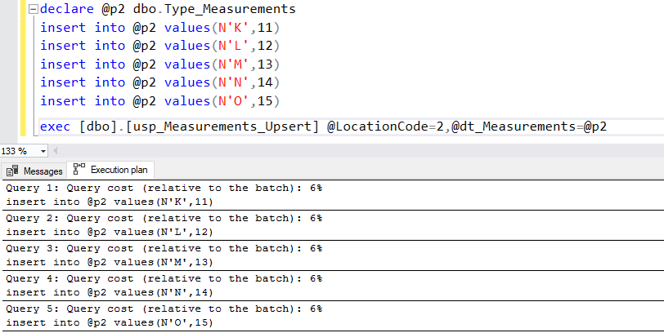

Performance-tuning a UDTT
Notes:
declare @p2 dbo.Type_Measurements
insert into @p2 values(N'K',11)
insert into @p2 values(N'L',12)
insert into @p2 values(N'M',13)
insert into @p2 values(N'N',14)
insert into @p2 values(N'O',15)
exec [dbo].[usp_Measurements_Upsert] @LocationCode=2,@dt_Measurements=@p2

Slide 29
Performance-tuning a UDTT (steps)
declare @p2 dbo.Type_Measurements
insert into @p2 values(N'K',11)
insert into @p2 values(N'L',12)
insert into @p2 values(N'M',13)
insert into @p2 values(N'N',14)
insert into @p2 values(N'O',15)
exec [dbo].[usp_Measurements_Upsert] @LocationCode=2,@dt_Measurements=@p2

Slide 30
Performance-tuning a UDTT (steps)
declare @p2 dbo.Type_Measurements
insert into @p2 values(N'K',11)
insert into @p2 values(N'L',12)
insert into @p2 values(N'M',13)
insert into @p2 values(N'N',14)
insert into @p2 values(N'O',15)
--exec [dbo].[usp_Measurements_Upsert] @LocationCode=2,@dt_Measurements=@p2

Slide 31
Performance-tuning a UDTT (steps)
declare @p2 dbo.Type_Measurements
insert into @p2 values(N'K',11)
insert into @p2 values(N'L',12)
insert into @p2 values(N'M',13)
insert into @p2 values(N'N',14)
insert into @p2 values(N'O',15)
SELECT * INTO #p2 FROM @p2
--exec [dbo].[usp_Measurements_Upsert] @LocationCode=2,@dt_Measurements=@p2

Slide 32
Performance-tuning a UDTT (steps)
declare @p2 dbo.Type_Measurements
--insert into @p2 values(N'K',11)
--insert into @p2 values(N'L',12)
--insert into @p2 values(N'M',13)
--insert into @p2 values(N'N',14)
--insert into @p2 values(N'O',15)
SELECT * INTO #p2 FROM @p2
--exec [dbo].[usp_Measurements_Upsert] @LocationCode=2,@dt_Measurements=@p2

Slide 33
Performance-tuning a UDTT (steps)
declare @p2 dbo.Type_Measurements
--insert into @p2 values(N'K',11)
--insert into @p2 values(N'L',12)
--insert into @p2 values(N'M',13)
--insert into @p2 values(N'N',14)
--insert into @p2 values(N'O',15)
SELECT * INTO #p2 FROM @p2
INSERT INTO @p2 SELECT * FROM #p2
--exec [dbo].[usp_Measurements_Upsert] @LocationCode=2,@dt_Measurements=@p2

Slide 34
Performance-tuning a UDTT (steps)
declare @p2 dbo.Type_Measurements
--insert into @p2 values(N'K',11)
--insert into @p2 values(N'L',12)
--insert into @p2 values(N'M',13)
--insert into @p2 values(N'N',14)
--insert into @p2 values(N'O',15)
--SELECT * INTO #p2 FROM @p2
INSERT INTO @p2 SELECT * FROM #p2
--exec [dbo].[usp_Measurements_Upsert] @LocationCode=2,@dt_Measurements=@p2

Slide 35
Performance-tuning a UDTT (steps)
declare @p2 dbo.Type_Measurements
--insert into @p2 values(N'K',11)
--insert into @p2 values(N'L',12)
--insert into @p2 values(N'M',13)
--insert into @p2 values(N'N',14)
--insert into @p2 values(N'O',15)
--SELECT * INTO #p2 FROM @p2
INSERT INTO @p2 SELECT * FROM #p2
exec [dbo].[usp_Measurements_Upsert] @LocationCode=2,@dt_Measurements=@p2

Slide 36
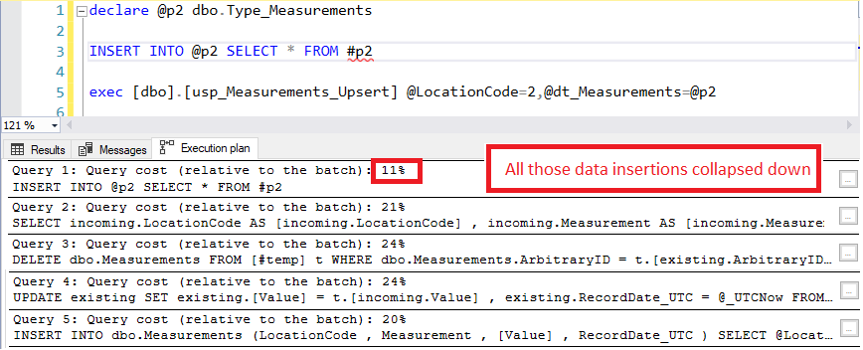
Performance-tuning a UDTT
Notes:
Should I be concerned with how much cost the inserts took?
Probably not, since these are a fixed cost. I cannot tune inserts into a table type.

Slide 37
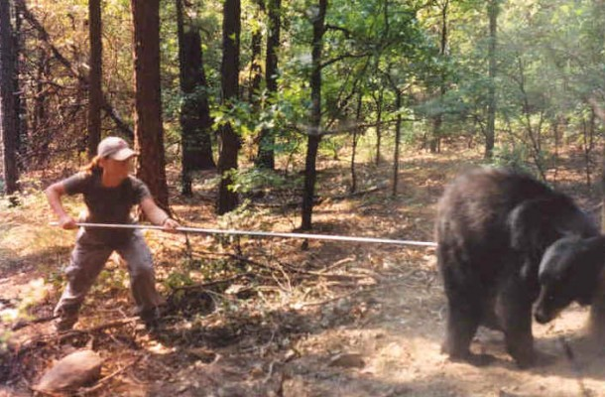
Let’s Anger It!

Slide 38
Let’s Anger It!
import random, string
def randomword(len):
letters = string.ascii_lowercase + string.digits
return ''.join(random.choice(letters) for i in range(len))
cols = ['Measurement', 'Value']
lst = []
for a in range(5000000):
lst.append([randomword(10), a])
df = pd.DataFrame(lst, columns=cols)

Slide 39
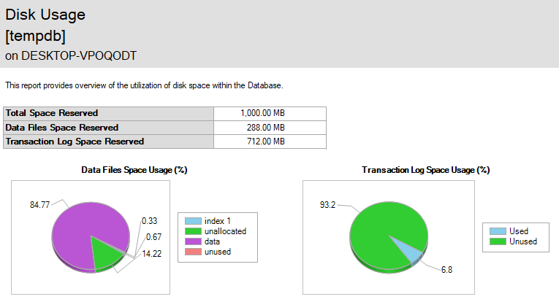

Slide 40
Where to go from here?
This is great, and I can’t wait to implement it back home!
I learned a lot about UDTTs, but I will continue to do things the way I currently insert data
This is great because now I can effectively argue against this solution

Slide 41


Slide 42
Jeff Foushee
SQL Server Database Admin
Programmer
SQL Saturday speaker
Blackjack dealer
https://www.linkedin.com/in/jeff-foushee/
https://github.com/jbfoushee/MyPresentations/

